Slide 1
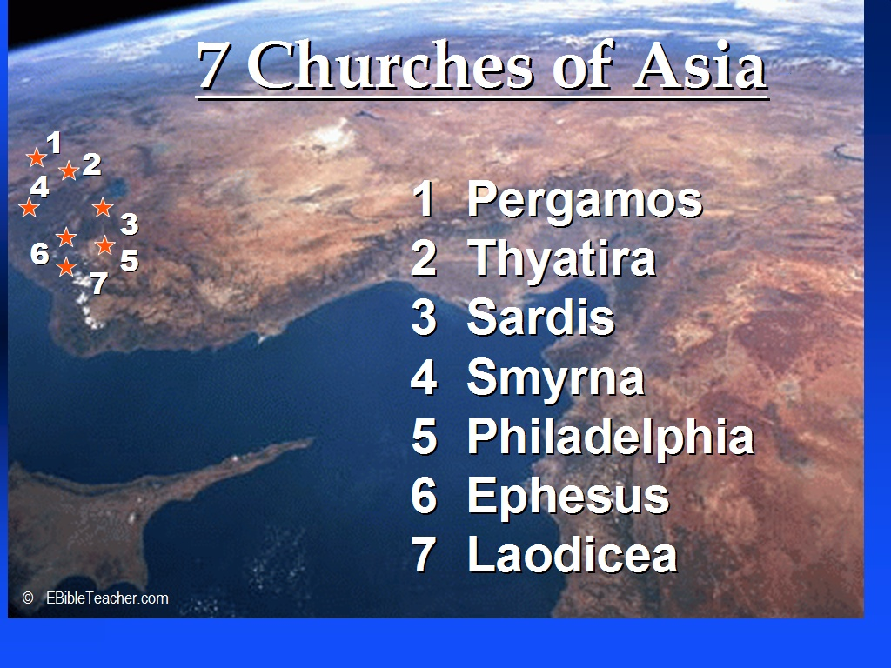
Revelation 2-3

Slide 2
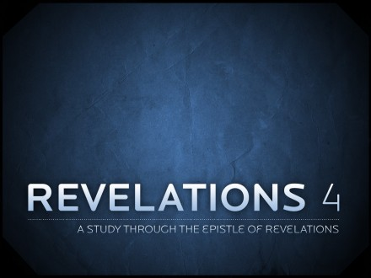

Slide 3
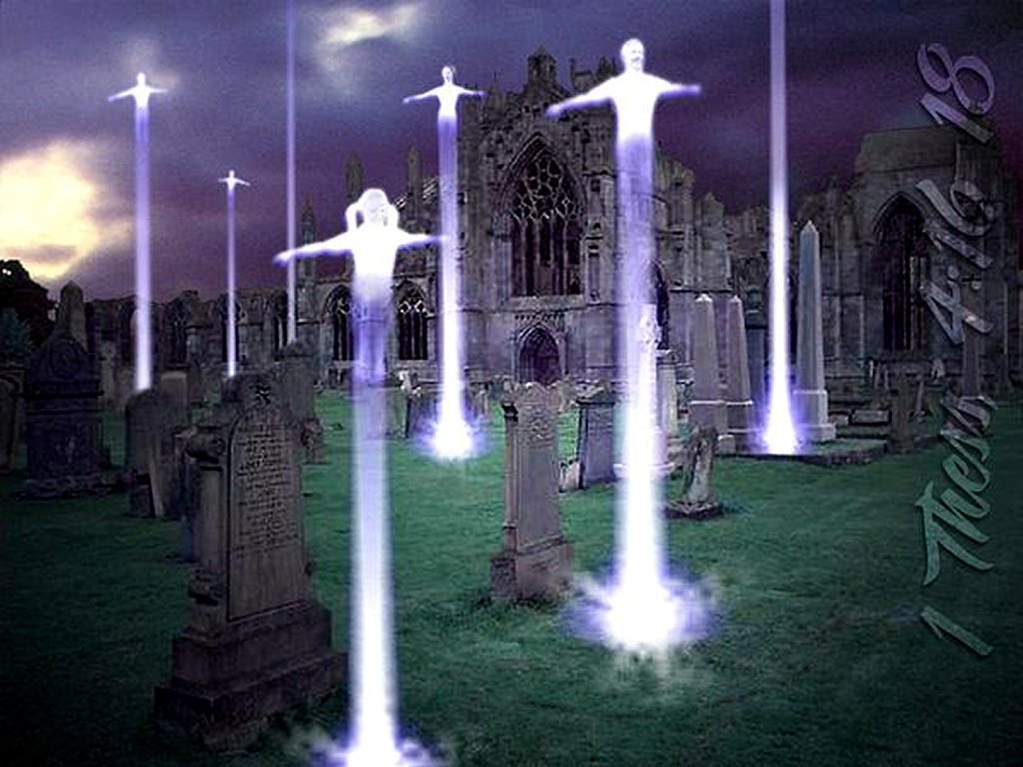
“For the Lord himself shall descend from heaven with a shout, with the voice of the archangel, and with the trump of God: and the dead in Christ shall rise first” (1 Thessalonians 4:16)
The Rapture occurs after Revelation 3 and before Revelation 4

Slide 4
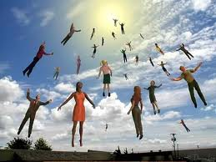
“Then we which are alive and remain shall be caught up together with them in the clouds, to meet the Lord in the air: and so shall we ever be with the Lord.” (1 Thessalonians 4:17)

Slide 5
Revelation 4:1-19:11 covers the period of the Seven Year Tribulation.
No Christians are left on earth during this period, because they have been raptured and taken to heaven to be with the Lord. Christians return with Christ at the Second Coming.

Slide 6
God’s Promise to believer in this the Church Age
“Because thou hast kept the word of my patience, I also will keep thee from the hour of temptation, which shall come upon all the world, to try them that dwell upon the earth.” (Revelation 3:10)

Slide 7
“But let us, who are of the day, be sober, putting on the breastplate of faith and love; and for an helmet, the hope of salvation. For God hath not appointed us to wrath, but to obtain salvation by our Lord Jesus Christ” (1 Thessalonians 5:8-9)

Slide 8
The Book of Revelation
Chapter 4:1-11
“. . . will show you things which must be hereafter.” (Revelation 4:1)
All rights reserved. Cooper P Abrams III

Slide 10
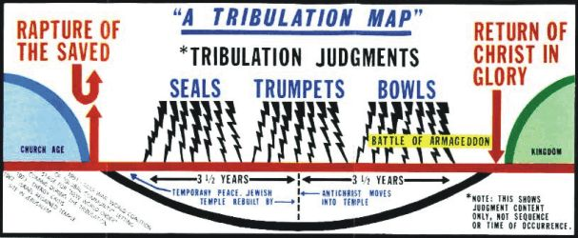

Slide 11

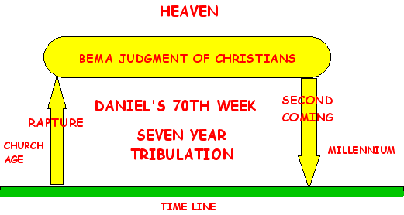

Slide 13

“After this I looked, and, behold, a door was opened in heaven: and the first voice which I heard was as it were of a trumpet talking with me; which said, Come up hither, and I will shew thee things which must be hereafter. “ (Revelation 4:1)

Slide 14
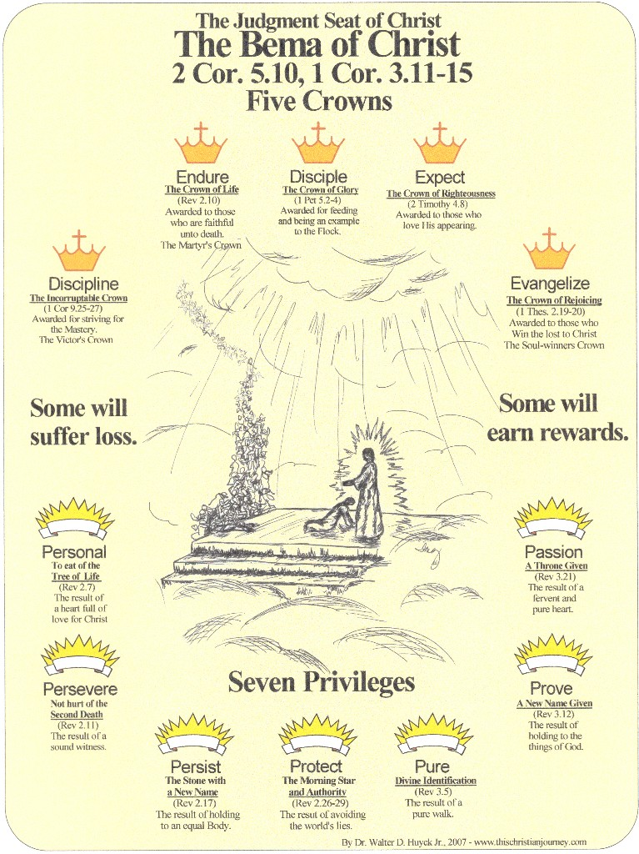

Slide 15
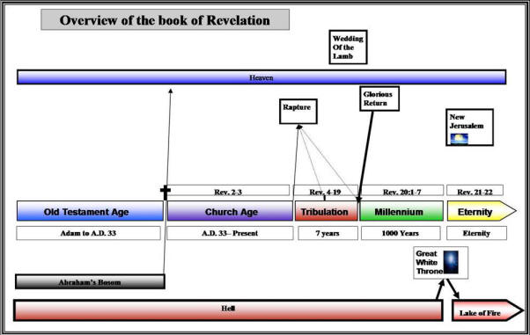

Slide 16
The Five Crowns – Reward received at the BEMA
The Incorruptible Crown. “Know ye not that they which run in a race run all, but one received the prize? So run, that ye may obtain. And every man that striveth for the mastery is temperate in all things. Now they do it to obtain a corruptible crown; but we an incorruptible.” (1 Corinthians 9:24-25)
The Crown of Rejoicing. ‘For what is our hope, or joy, or crown of rejoicing? Are not even ye in the presence of our Lord Jesus Christ at his coming?” (1 Thessalonians 2:19)
The Crown of Righteousness. “I have fought a good fight, I have finished my course, I have kept the faith: Henceforth there is laid up for me a crown of righteousness, which the Lord, the righteous judge, shall give me at that day: and not to me only, but unto all them also that love his appearing.” (2 Timothy 4:7-8)
The Crown of Life. “Blessed is the man that endureth temptation: for when he is tried, he shall receive the crown of life, which the Lord hath promised to them that love him.” (James 1:12)
The Crown of Glory. “Feed the flock of God which is among you, taking the oversight thereof, not by constraint, but willingly; not for filthy lucre, but of a ready mind; Neither as being lords over God's heritage, but being ensamples to the flock. And when the chief Shepherd shall appear, ye shall receive a crown of glory that fadeth not away.” (1 Peter 5:2-4)

Slide 17
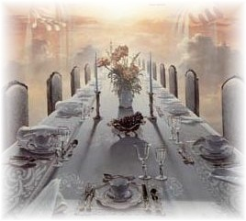
The Marriage Supper of the Lamb (Rev. 19:9)

Slide 18
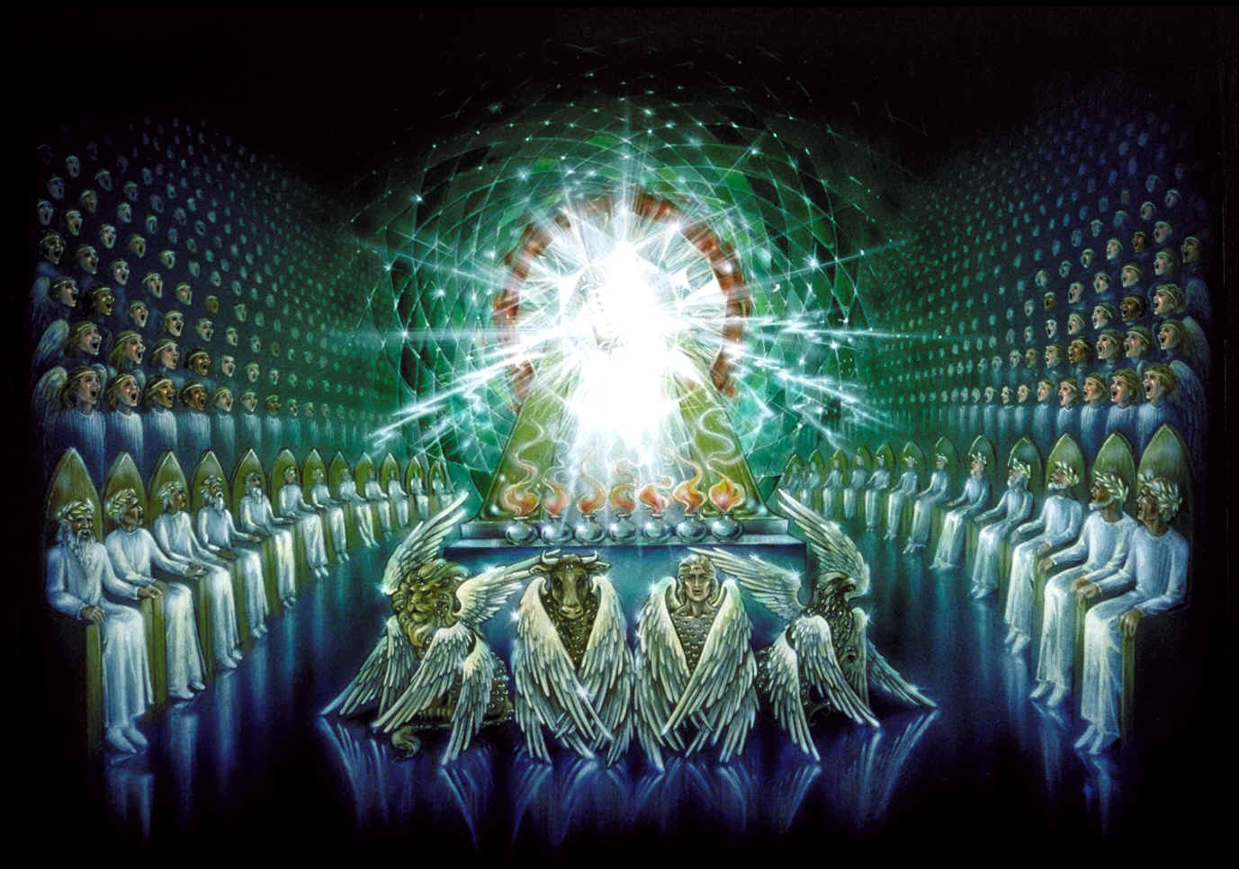
“And immediately I was in the spirit: and, behold, a throne was set in heaven, and one sat on the throne.” (Revelation 4:2)
The Throne of God

Slide 19
“And round about the throne were four and twenty seats: and upon the seats I saw four and twenty elders sitting, clothed in white raiment; and they had on their heads crowns of gold.” (Revelation 4:4)
The Throne of God

Slide 20
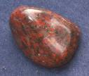
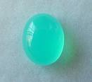
“And he that sat was to look upon like a jasper and a sardine stone: and there was a rainbow round about the throne, in sight like unto an emerald.” (Revelation 4:3)
Jasper
Chalcedony (Sardine)

Slide 21
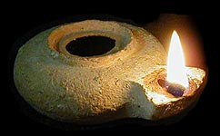
And out of the throne proceeded lightnings and thunderings and voices: and there were seven lamps of fire burning before the throne, which are the seven Spirits of God. (Revelation 4:5)
The seven-fold ministry of the Holy Spirit:
Restraining Baptizing
Convicting Indwelling
Regenerating Filling
Sealing

Slide 22
“And before the throne there was a sea of glass like unto crystal: and in the midst of the throne, and round about the throne, were four beasts full of eyes before and behind. And the first beast was like a lion, and the second beast like a calf, and the third beast had a face as a man, and the fourth beast was like a flying eagle.” (Revelation 4:6-7)

Slide 23
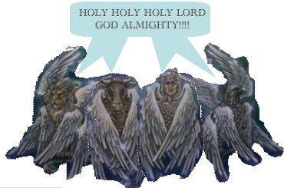
Lion Judah, Issachar and Zabulon
Calf or Ox Ephraim /tribes of Manasseh and Benjamin
Face of Man Tribe of Reuben, Gad and Simeon
Eagle Dan , Asher and Naphti

Slide 24
“The four and twenty elders fall down before him that sat on the throne, and worship him that liveth for ever and ever, and cast their crowns before the throne, saying,” (Revelation 4:10)

Slide 25
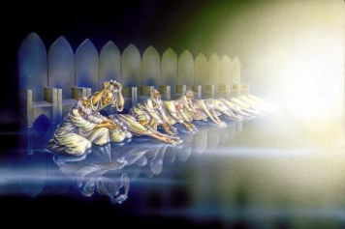
The Twenty-four Elders – Rev. 4:4

Slide 26
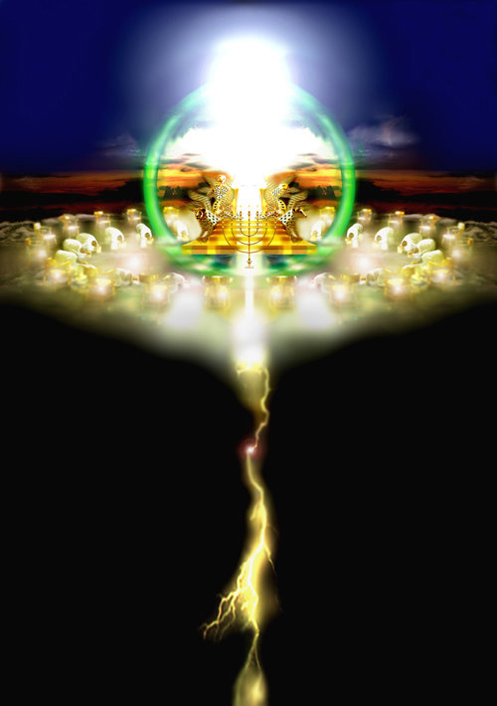

Slide 27
“Thou art worthy, O Lord, to receive glory and honour and power: for thou hast created all things, and for thy pleasure they are and were created.” (Revelation 4:11)

