Slide 1
Revelation Chapter Six
The Beginning of the Seven Year Tribulation – The Seven Seal Judgments
Revelation 6:1 – 8:1

Slide 2
There are a number of parallels between Matthew 24 and Revelation 6:
(1) War. Matt. 24:6-7 Rev. 6:3-4
(2) Famine. Matt. 24:7 Rev. 6:5-6
(3) Death. Matt. 24:7-8 Rev. 6:7-8
(4) Martyrdom. Matt. 24:9-10 Rev. 6:9-11, 24:16-22
(5) Sun, Moon
darken and
Stars fall. Matt. 24:29 Rev. 6:12-14

Slide 3

“And I saw when the Lamb opened one of the seals, and I heard, as it were the noise of thunder, one of the four beasts saying, Come and see.” (Revelation 6:1)

Slide 4
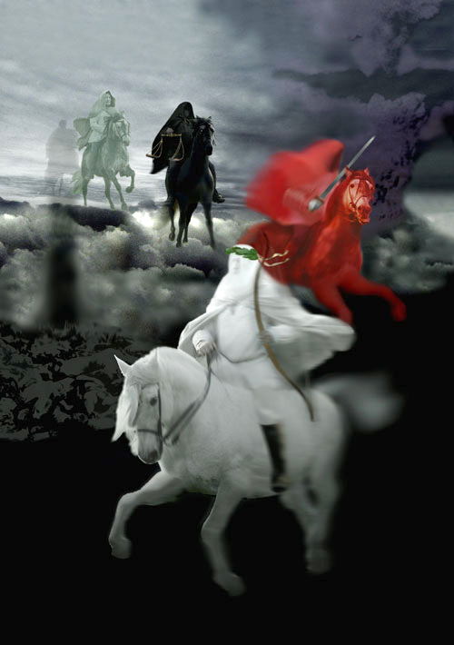
THE FOUR HORSEMENT
OF THE APOCALYPSE
Revelation 6:2-8

Slide 5
The characteristic of the first Rider:
(1) symbolism of the horse – he charges in.
(2) the color of the horse is white – he comes as a ruler of peace.
(3) he has a bow – he presents himself as a man of peace, but carries a weapon – a bow to kill.
(4) his crown that is indicative of a rule who is victorious.

Slide 6
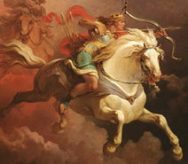
“And I saw, and behold a white horse: and he that sat on him had a bow; and a crown was given unto him: and he went forth conquering, and to conquer.” (Revelation 6:2)
The Antichrist

Slide 7
The Antichrist makes a peace treaty to protect Israel:
“And he shall confirm the covenant with many for one week: and in the midst of the week he shall cause the sacrifice and the oblation to cease, and for the overspreading of abominations he shall make it desolate, even until the consummation, and that determined shall be poured upon the desolate. “ (Daniel 9:27)

Slide 8
The idea which the word conveys appears frequently in Scripture.
“After this I saw in the night visions, and behold a fourth beast, dreadful and terrible, and strong exceedingly; and it had great iron teeth: it devoured and brake in pieces, and stamped the residue with the feet of it: and it was diverse from all the beasts that were before it; and it had ten horns. I considered the horns, and, behold, there came up among them another little horn, before whom there were three of the first horns plucked up by the roots: and, behold, in this horn were eyes like the eyes of man, and a mouth speaking great things. “ (Daniel 7:7-8)

Slide 9
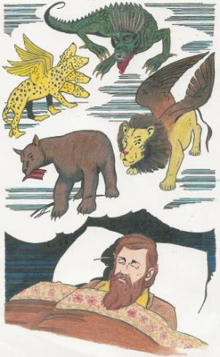
Daniel 7:1-8

Slide 10
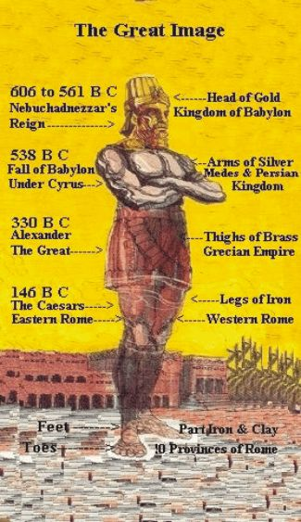
In Daniel’s vision he saw the five great nations that would arise until the Second Coming of Jesus Christ.

Slide 11
A Comparison Between the Two Visions
The Nation
Nebuchadnezzar’s Dream Symbolized Daniel's Vision
Daniel 2:31-36 Daniel 7:1-14
Head was of fine gold Babylon This beast was like a lion with eagle’s wings . Its wings are plucked, and it was made to stand up like a man on its feet, and was given a man's heart.
Chest and arms of silver Medo-Persians Bear which raised its self on one side. It had three ribs in its mouth between its teeth. It was told to arise and devour much flesh.
Belly and thighs of bronze Greeks Leopard, had four wings on its back like a bird and had four heads and was given dominion to rule .

Slide 12
Legs of Iron Romans This beast was dreadful, terrible and strong with great teeth. It devourer and brake in pieces. It stamped the residue with its feet. It was not like the other beasts. It had ten horns.
Feet of Iron and Clay Revived Roman A little horn arises among the ten horns. Mixed Empire This little horn plucks up three of the first ten horns. Has eyes like a man and mouth speaks great things with its mouth.

Slide 13
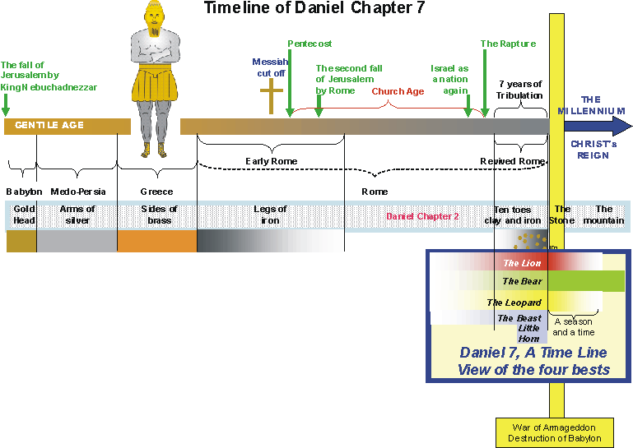

Slide 14
“And there appeared another wonder in heaven; and behold a great red dragon, having seven heads and ten horns, and seven crowns upon his heads.” (Revelation 12:3)
Compare with:
“After this I saw in the night visions, and behold a fourth beast, dreadful and terrible, and strong exceedingly; and it had great iron teeth: it devoured and brake in pieces, and stamped the residue with the feet of it: and it was diverse from all the beasts that were before it; and it had ten horns.” (Daniel 7:7)

Slide 15
Note the events of Daniel 7:18-27

Slide 16
The word "antichrist" occurs only in:
“Little children, it is the last time: and as ye have heard that antichrist shall come, even now are there many antichrists; whereby we know that it is the last time.” (1 John 2:18)
“And every spirit that confesseth not that Jesus Christ is come in the flesh is not of God: and this is that spirit of antichrist, whereof ye have heard that it should come; and even now already is it in the world. “ (1 John 4:3)
“For many deceivers are entered into the world, who confess not that Jesus Christ is come in the flesh. This is a deceiver and an antichrist. “ (2 John 1:7)

Slide 17
The False Prophet:
“And I beheld another beast coming up out of the earth; and he had two horns like a lamb, and he spake as a dragon. And he exerciseth all the power of the first beast before him, and causeth the earth and them which dwell therein to worship the first beast, whose deadly wound was healed. And he doeth great wonders, so that he maketh fire come down from heaven on the earth in the sight of men, And deceiveth them that dwell on the earth by the means of those miracles which he had power to do in the sight of the beast; saying to them that dwell on the earth, that they should make an image to the beast, which had the wound by a sword, and did live.” (Revelation 13:11-14)
Some conclude this is the Roman Catholic Church. This is a world wide religion of the Antichrist which makes its scope larger. All false churches and religions will be a part of this world wide religion.

Slide 18
The Antichrist aided by the False Prophecy will establish a “new world order.”
Current organizations promoting ecumentalism:
World Council of Churches. The WCC is a unique space: one in which they can reflect, speak, act, worship and work together, challenge and support each other, share and debate with each other. As members of this fellowship, WCC member churches:
1. Are called to the goal of visible unity in one faith and one eucharistic (sacraments ) fellowship.
2. Promote their common witness in work for mission and evangelism.
3. Engage in Christian service by serving human need, breaking down barriers between people, seeking justice and peace, and upholding the integrity of creation; and foster renewal in unity, worship, mission and service.

Slide 19
Who are members of the WCC?
Roman Catholics
Most Protestant denominations and churches
Most Pentecostal and Charismatic churches
Some apostate Baptists churches.
No Independent Baptist Church is a
member of the WCC or the NCC.

Slide 20
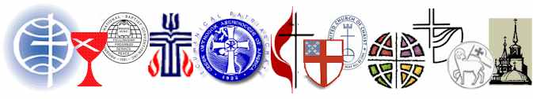
The National Council of Churches. NCC (USA)
Statement of Faith
  "The National Council of Churches is a community of Christian communions, which, in response to the gospel as revealed in the Scriptures, confess Jesus Christ, the incarnate Word of God, as Savior and Lord.
  These communions covenant with one another to manifest ever more fully the unity of the Church.
  Relying upon the transforming power of the Holy Spirit, the communions come together as the Council in common mission,
  serving in all creation to the glory of God."
--from the Preamble to the NCC Constitution.

Slide 21
What is the ecumential adgenda?
Unity between all “Christian” groups without regard for doctrine or practice.
Bible is the not the inspired word of God.
Evolutionists
Many of their leaders deny the deity of Jesus Christ, the miracle, virgin birth, hell, etc.
Most of their churches preach a social “gospel” with promotes socialism and Marxist philosophy.
The modern trend is toward a “Super church” of total unity.
Many teach that belief in Jesus Christ and the Bible is only one of many ways to heaven.

Slide 22
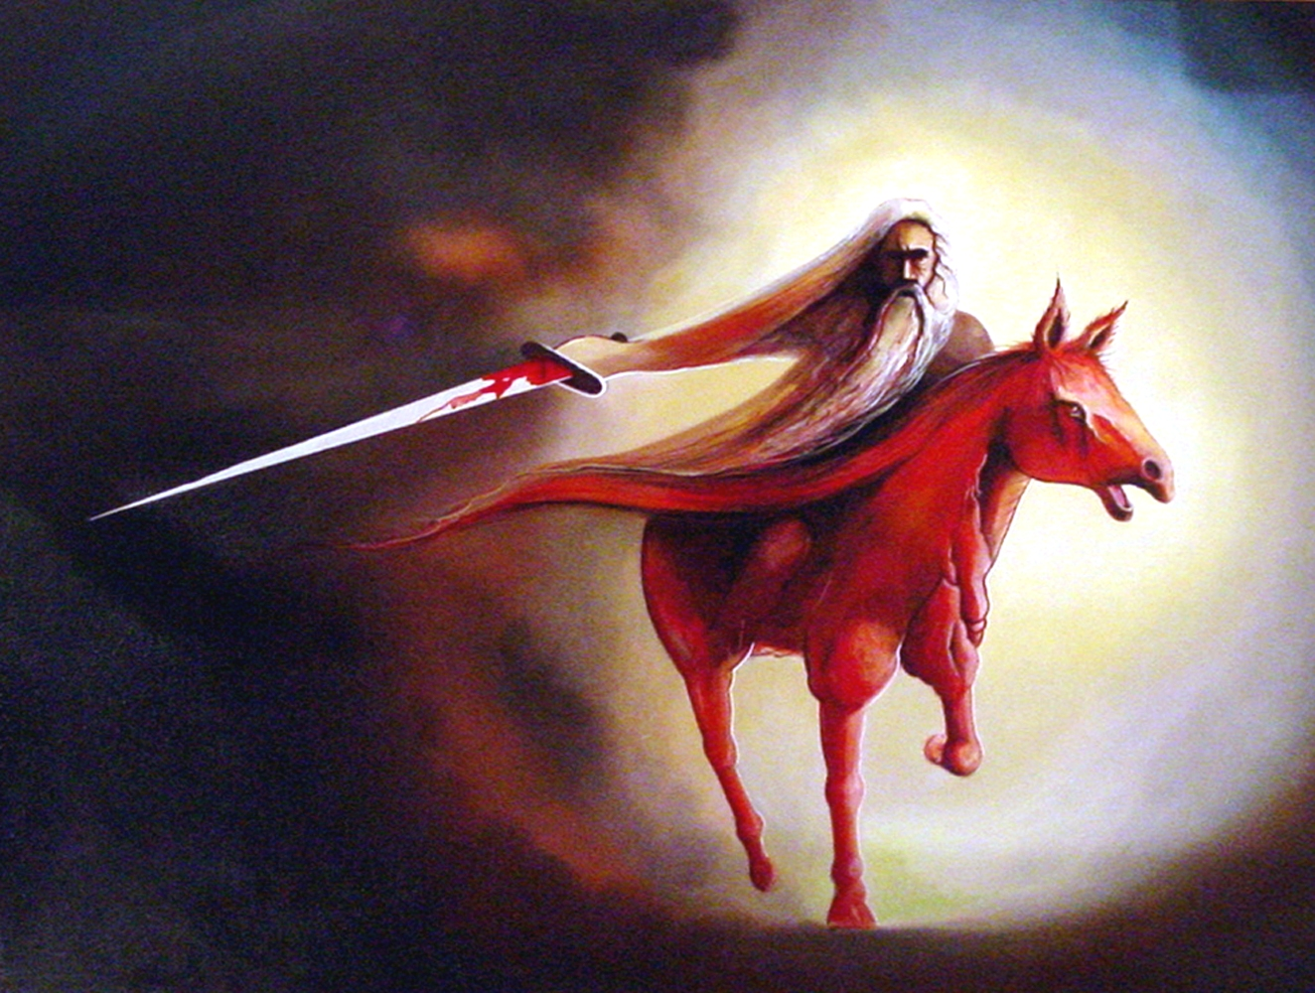
“And when he had opened the second seal, I heard the second beast say, Come and see. And there went out another horse that was red: and power was given to him that sat thereon to take peace from the earth, and that they should kill one another: and there was given unto him a great sword.” (Revelation 6:3-4)

Slide 23
“And ye shall hear of wars and rumours of wars: see that ye be not troubled: for all these things must come to pass, but the end is not yet. For nation shall rise against nation, and kingdom against kingdom: and there shall be famines, and pestilences, and earthquakes, in divers places. All these are the beginning of sorrows.” (Matthew 24:6-8)

Slide 24
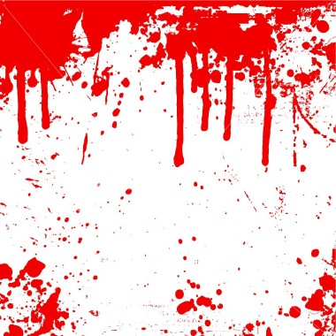

The color of this rider’s horse is red which symbolized blood.

Slide 25
The Antichrist reveals his true character of lusting for power.
“For when they shall say, Peace and safety; then sudden destruction cometh upon them, as travail upon a woman with child; and they shall not escape. “ (1 Thessalonians 5:3)
He first came deceptively offering peace, but all the while planning war.
Nation will turn on nation

Slide 26
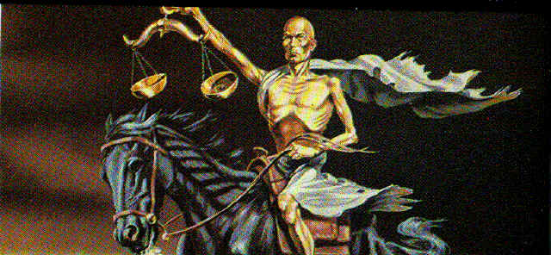


“And when he had opened the third seal, I heard the third beast say, Come and see. And I beheld, and lo a black horse; and he that sat on him had a pair of balances in his hand. And I heard a voice in the midst of the four beasts say, A measure of wheat for a penny, and three measures of barley for a penny; and see thou hurt not the oil and the wine.’ (Revelation 6:5-6)

Slide 27

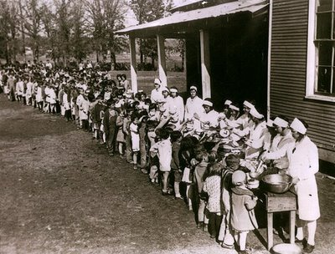

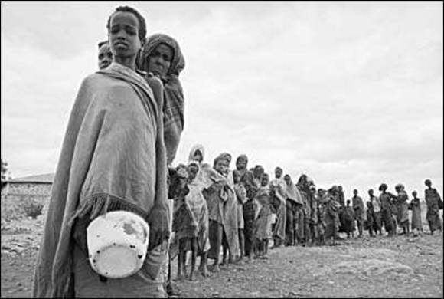
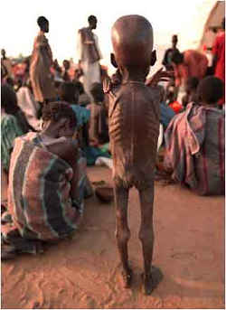
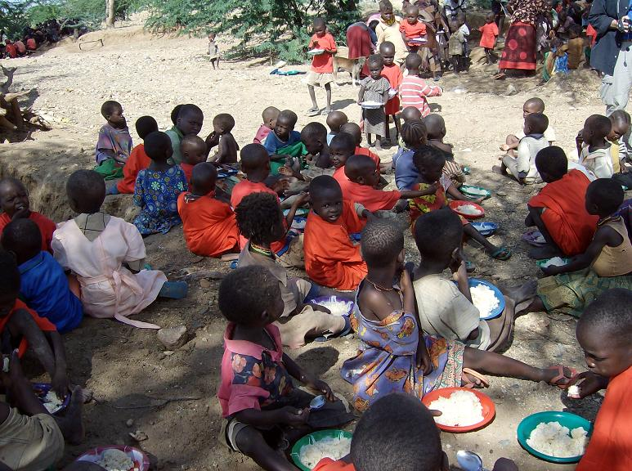

Slide 28

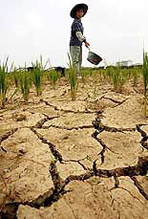
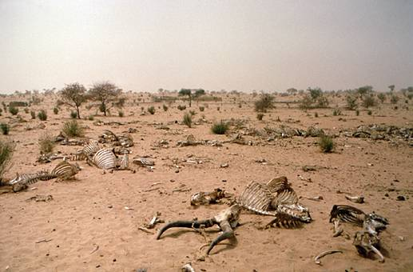
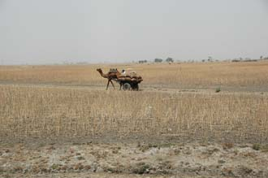

Slide 29
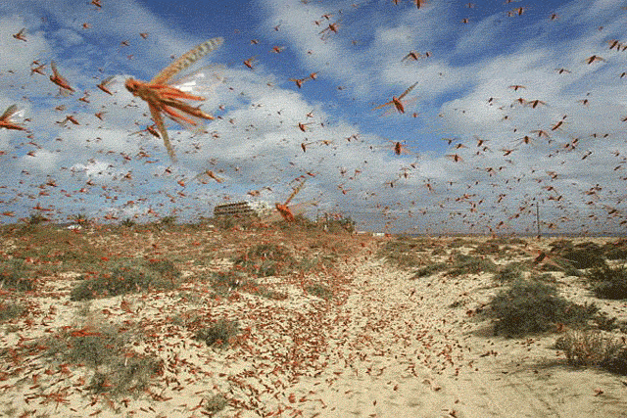

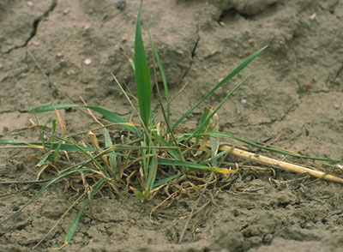

Slide 30
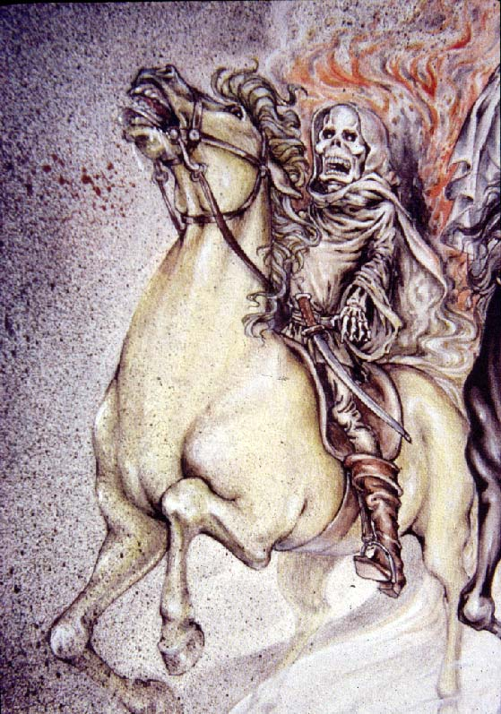
“And I looked, and behold a pale horse: and his name that sat on him was Death, and Hell followed with him. And power was given unto them over the fourth part of the earth, to kill with sword, and with hunger, and with death, and with the beasts of the earth.” (Revelation 6:8)

Slide 31
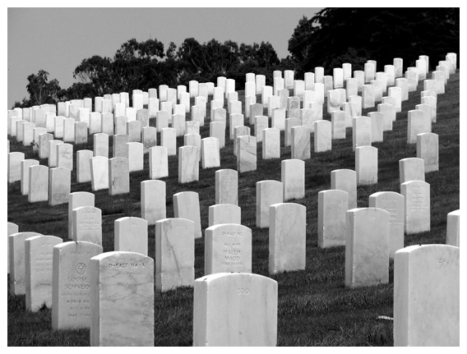
Death !

Slide 32
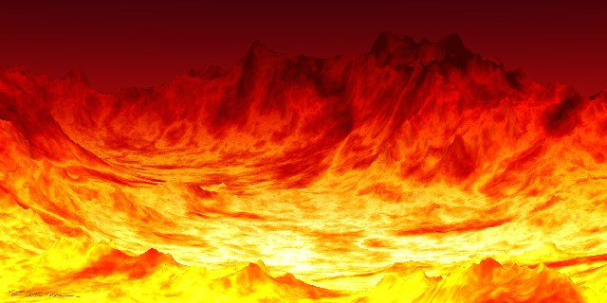
HELL !

Slide 33
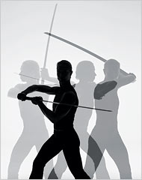
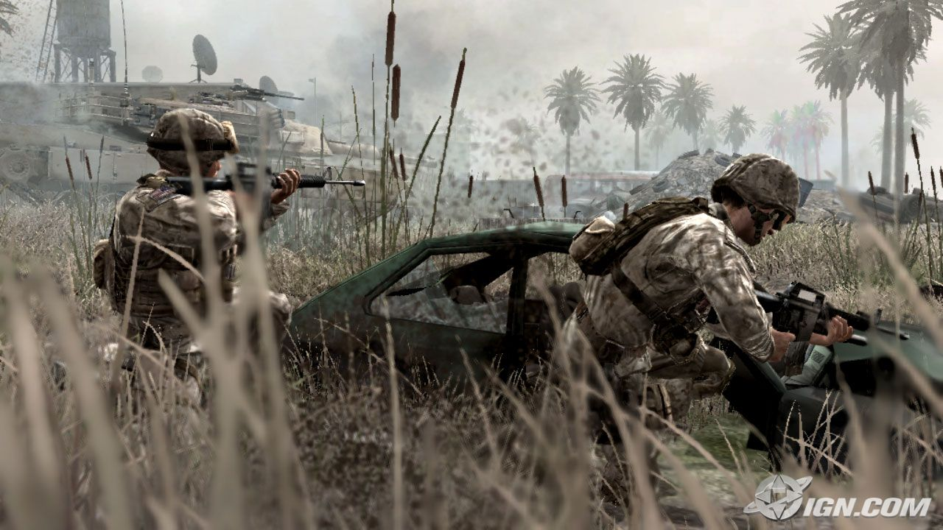
The Pale Horse Rider Kills with:
Sword:

Slide 34

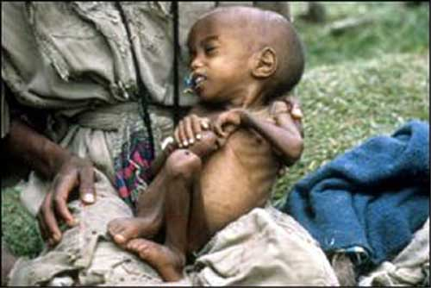
Hunger !

Slide 35
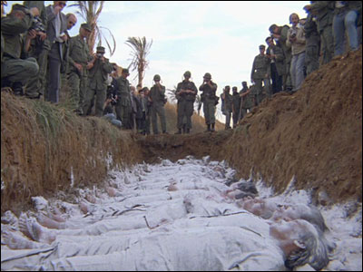
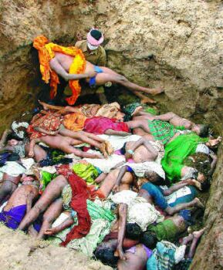
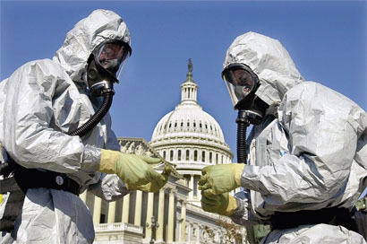
Death!
Epidemics like bird flu

Slide 36

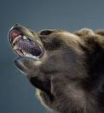
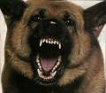
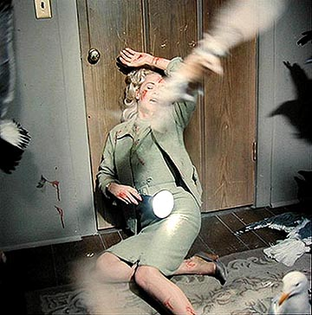
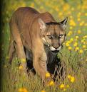
Beasts of the earth killing men!

Slide 37
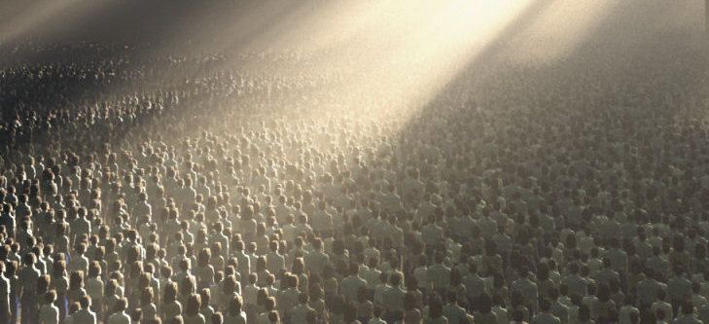
“And when he had opened the fifth seal, I saw under the altar the souls of them that were slain for the word of God, and for the testimony which they held” (Revelation 6:9)

Slide 38
“And they cried with a loud voice, saying, How long, O Lord, holy and true, dost thou not judge and avenge our blood on them that dwell on the earth?’” (Revelation 6:10)

