Slide 1
Revelation Chapter Seven
The 144,000 sealed Jews and the multitude of saved Tribulation saints

Slide 2
“And after these things I saw four angels standing on the four corners of the earth, holding the four winds of the earth, that the wind should not blow on the earth, nor on the sea, nor on any tree. And I saw another angel ascending from the east, having the seal of the living God: and he cried with a loud voice to the four angels, to whom it was given to hurt the earth and the sea, Saying, Hurt not the earth, neither the sea, nor the trees, till we have sealed the servants of our God in their foreheads. “ (Revelation 7:1-3)

Slide 3
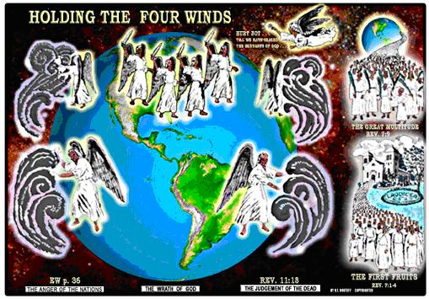

Slide 4
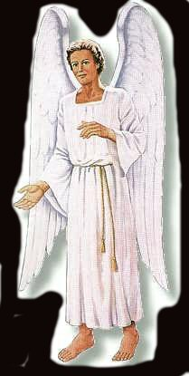
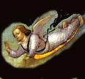
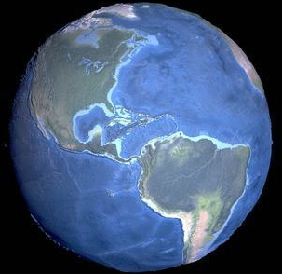
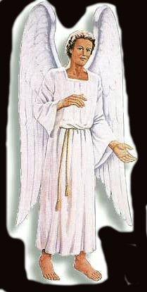
Wait
Wait !
Rev. 7:1-3

Slide 5
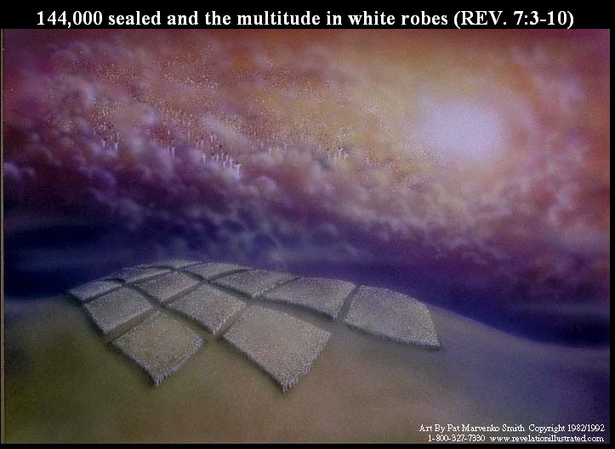

Slide 6
Revelation 7:11-12 - the scene in heaven.
Worshiping the Lord are:
ALL the angels
The elders
The four beasts (Rev. 4:6, 8; 5:6, 8,14; 6:1, 6; 7:11; 14:3, 15:7; 19:4)

Slide 7
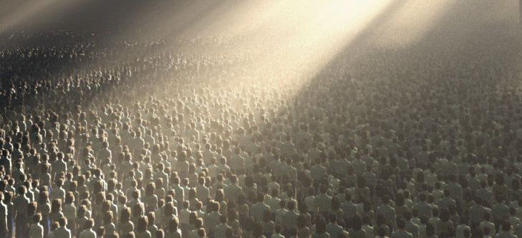
“And one of the elders answered, saying unto me, What are these which are arrayed in white robes? and whence came they? “ (Revelation 7:13)
“And I said unto him, Sir, thou knowest. And he said to me, These are they which came out of great tribulation, and have washed their robes, and made them white in the blood of the Lamb.” (Revelation 7:14)

Slide 8
“Therefore are they before the throne of God, and serve him day and night in his temple: and he that sitteth on the throne shall dwell among them. They shall hunger no more, neither thirst any more; neither shall the sun light on them, nor any heat. For the Lamb which is in the midst of the throne shall feed them, and shall lead them unto living fountains of waters: and God shall wipe away all tears from their eyes. “(Revelation 7:15-17)

Slide 9
End Revelation 7:1-17

